Slide 1

Lecture 25.1
Dimensionality reduction techniques
Nicola Romanò nicola.romano@ed.ac.uk

Slide 2
Learning objectives
At the end of this lecture and practical this afternoon you should be able to:
Explain what dimensionality reduction techniques are and why are they used
Describe the idea (and some simple process) behind principal component analysis
Perform, visualise and analyse PCA using R
Notes:
<number>

Slide 3
Measuring gene expression!
We are interested in measuring gene expression in three sets of patients
Control group (Ctrl) : no liver pathology
Liver fibrosis group (Fibr) : patients with liver fibrosis
Liver cirrhosis group (Cir) : patients with liver cirrhosis
10 patients / group
RNA extracted from liver biopsy, RT-PCR, then expression of target genes assessed by qPCR.
Notes:
<number>

Slide 4
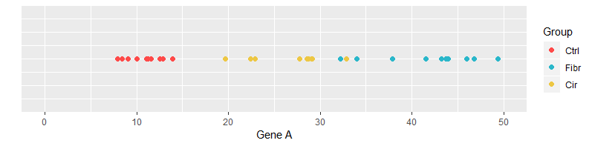
Experiment 1 – 1 gene
Very simple experiment – we only measure gene A
 | Patient 1 | Patient 2 | Patient 3 | Patient 4 | Patient 5 | … | Patient 30
A | 12.5 | 13.9 | 8.4 | 11.3 | 12.9 | … | 22.4
Notes:
1D plot, we can clearly see clustering (in this case). This means red vs red dots are more similar than red vs blue
<number>

Slide 5
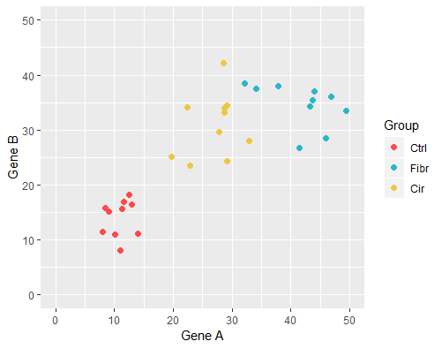
Experiment 2 – 2 genes
Now we measure 2 genes
 | Patient 1 | Patient 2 | Patient 3 | Patient 4 | Patient 5 | … | Patient 30
A | 12.5 | 13.9 | 8.4 | 11.3 | 12.9 | … | 22.4
B | 18.2 | 11.1 | 16.4 | 15.8 | 15.6 | …. | 24.3
Notes:
<number>

Slide 6
Experiment 3 – 10 genes
Now we measure 10 genes
 | Patient 1 | Patient 2 | Patient 3 | Patient 4 | Patient 5 | … | Patient 30
A | 12.5 | 13.9 | 8.4 | 11.3 | 12.9 | … | 22.4
B | 18.2 | 11.1 | 16.4 | 15.8 | 15.6 | …. | 24.3
… | …. | …. | …. | …. | …. | …. | ….
J | 32.7 | 28.0 | 30.9 | 42.8 | 31.4 |  | 28.5
Would need a 10D plot!!!!
Notes:
<number>

Slide 7
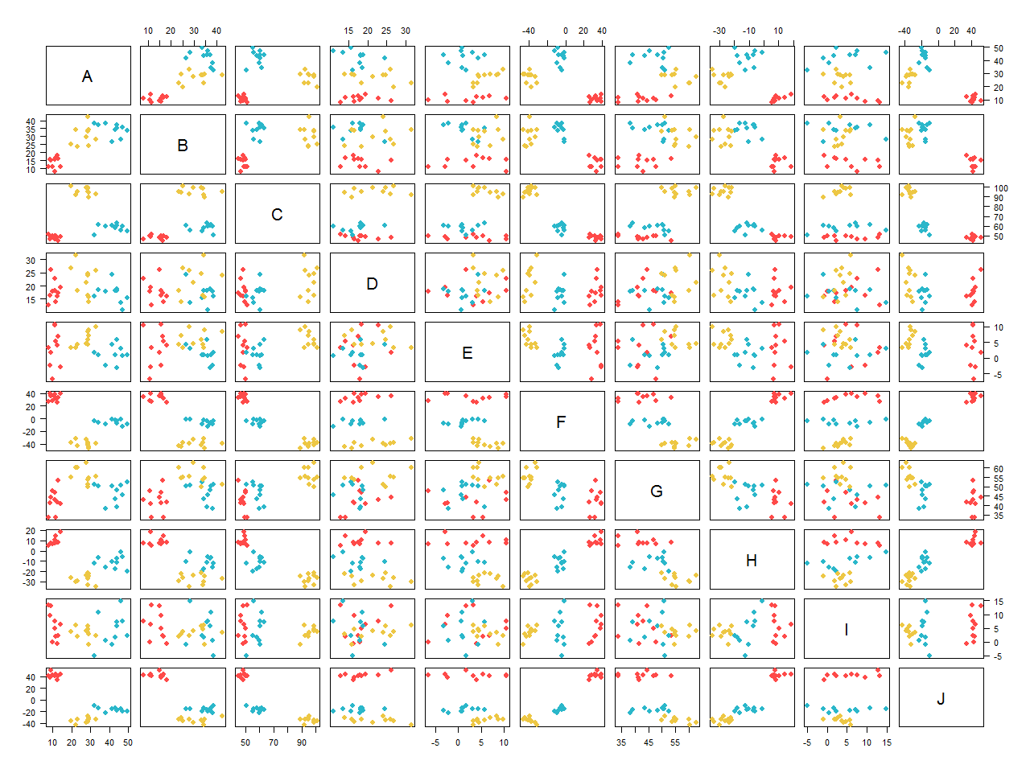
Experiment 3 – 10 genes
Notes:
OK-ish with 10 variables, imagine if we had 1000s!
<number>

Slide 8
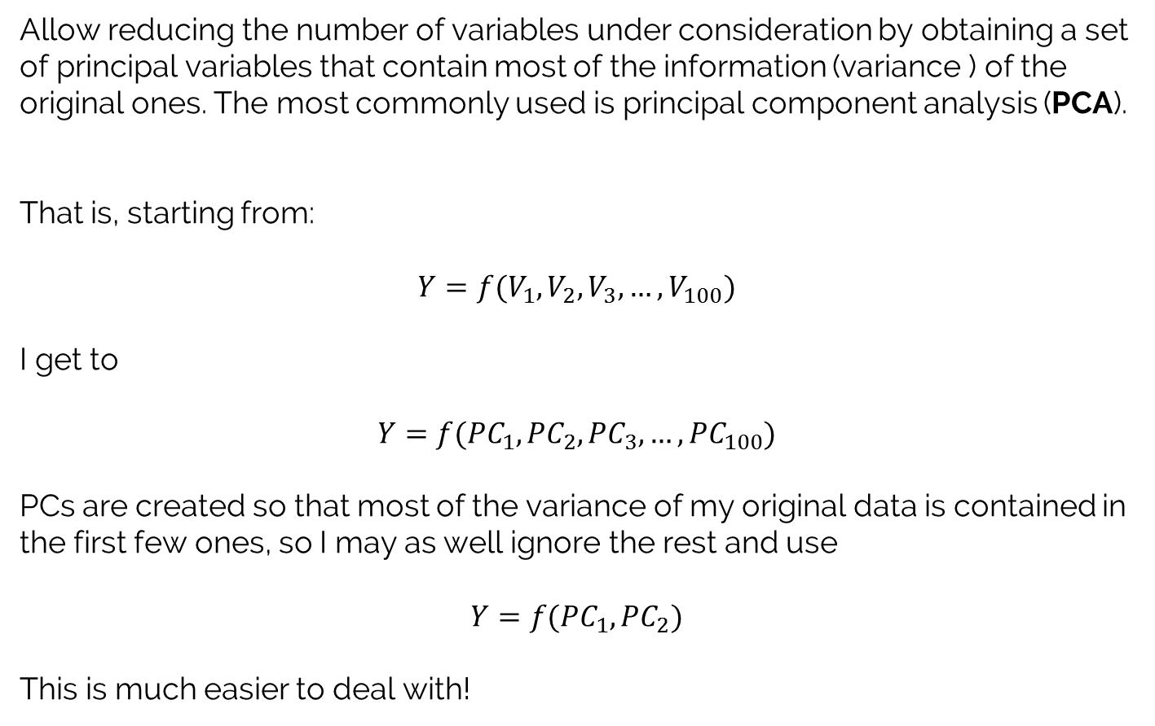
Dimensionality reduction techniques
PC = principal component;
each PC is a linear combination of the original variables
Notes:
<number>

Slide 9
Experiment 3 – 10 genes
I start from
 | Patient 1 | Patient 2 | Patient 3 | Patient 4 | Patient 5 | … | Patient 30
A | 12.5 | 13.9 | 8.4 | 11.3 | 12.9 | … | 22.4
B | 18.2 | 11.1 | 16.4 | 15.8 | 15.6 | …. | 24.3
… | …. | …. | …. | …. | …. | …. | ….
J | 32.7 | 28.0 | 30.9 | 42.8 | 31.4 |  | 28.5
I get to
 | Patient 1 | Patient 2 | Patient 3 | Patient 4 | Patient 5 | … | Patient 30
PC1 | -56.73 | -74.9 | -69.4 | -69.0 | -66.0 | … | 54.7
PC2 | -4.2 | -5.6 | -5.1 | -8.3 | -5.6 | …. | -14.9
Notes:
<number>

Slide 10
How to do PCA?
Following is a simplified view of how PCA is calculated.
If you really really want to actually learn the maths behind PCA, this is a good start (note, lots of matrix calculus involved!):
A Tutorial on Principal Component Analysis, Jonathon Shlens, 2005
The last R workshop will teach you how to do it using R (no fancy math involved!!!)
Notes:
<number>

Slide 11
Back to 2 genes!
 | Patient 1 | Patient 2 | Patient 3 | Patient 4 | Patient 5 | … | Patient 30
A | 12.5 | 13.9 | 8.4 | 11.3 | 12.9 | … | 22.4
B | 18.2 | 11.1 | 16.4 | 15.8 | 15.6 | …. | 24.3
Notes:
<number>

Slide 12
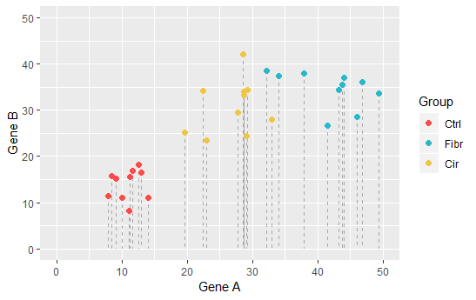
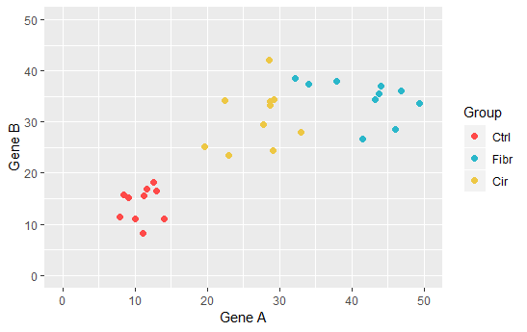
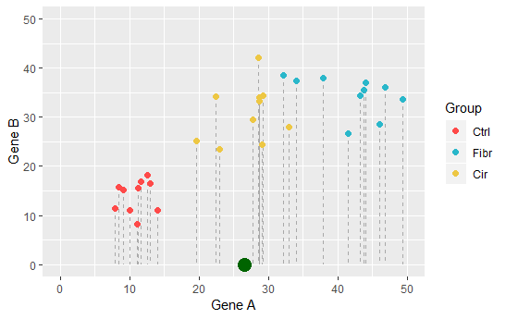
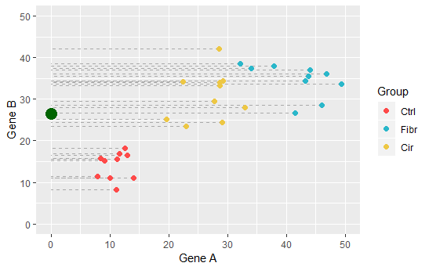
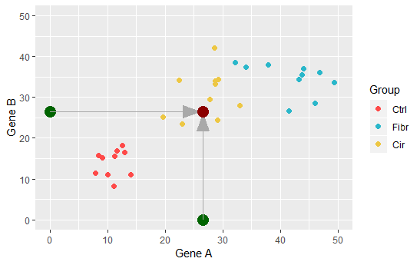
Step 1 – center data
The first thing we want to do is center the data on the origin.
We do this by projecting the data on each dimension (= each axis) and find the mean.
We then subtract the mean from each point
Notes:
<number>

Slide 13
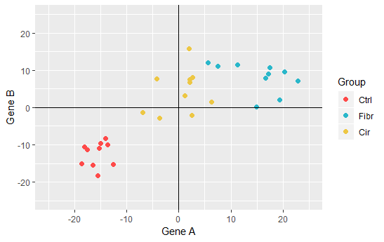
Step 1 – center data
Now our data are centred on (0;0)
Note: if we had more than 2 dimensions, we would shift the data in all of them, and centre them at (0; 0; 0; …; 0)
Notes:
Note: shifting the data does not change the relationship between data points
<number>

Slide 14
Step 2 – fit a best line
We now want to fit a best fitting line to the data making sure it goes through the origin.
Notes:
<number>

Slide 15
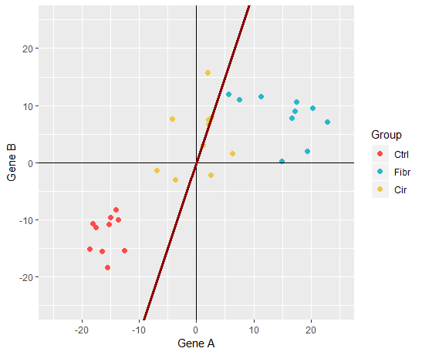
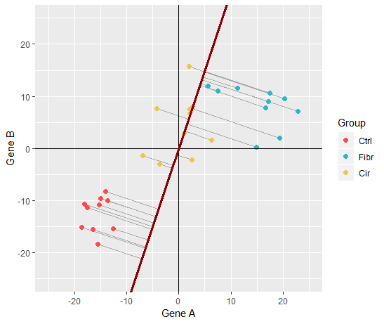
Step 2 – a random line…
PCA tries to minimise the distance from each point to the line
This is equal to maximise the distance between the projection and the origin.
Note that PCA minimises (or maximises) the sum of squares of the distances
Notes:
<number>

Slide 16
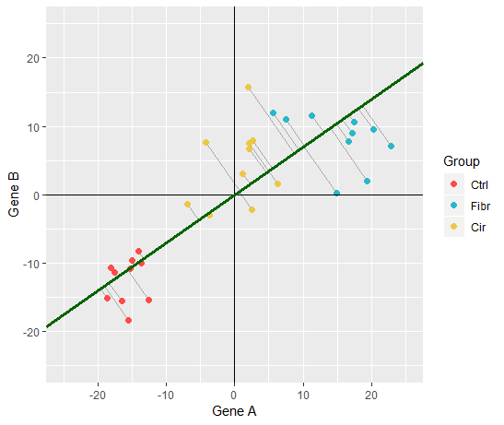
Step 2 – find the best line
Notes:
This was found through some clever matrix algebra. We don’t care about it for the context of this course. R will find it for us.
<number>

Slide 17
You got PC1 !
Notes:
This means that for each 10 units on gene A we go up 7 units in gene B
It also means that most of the variance of my dataset is derived by gene A.
So gene A is more important then gene B when we describe our data.
<number>

Slide 18
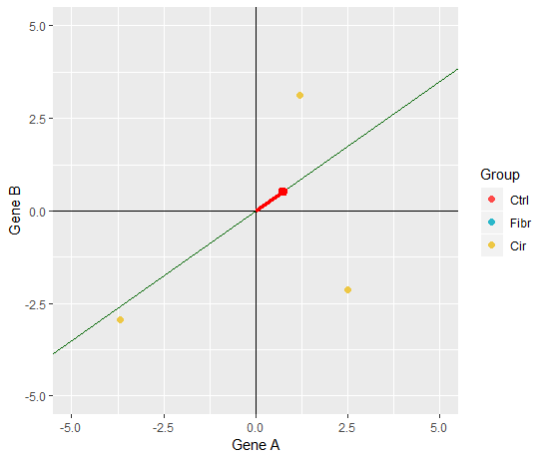
Some PCA terminology
The unit vector (= vector of length 1) on PC1 is called the PC1 eigenvector.
In our example it is (0.818; 0.574) <- these are called the PC1 loading scores.
The SS of the distances of the projection to the origin is called the PC1 eigenvalue.
Notes:
Note the scale change
Note that 0.818/0.574 = 10/7
<number>

Slide 19
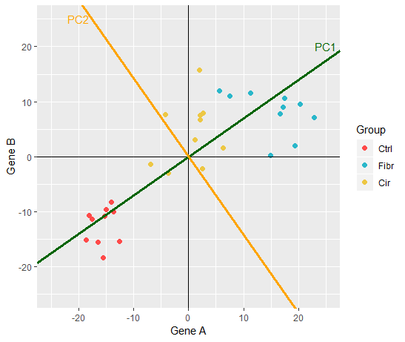
Let’s find PC2!
PC1 is the line perpendicular to PC1, passing through the origin and that minimised the SS distances of the points. In our simple 2D example there is only one line to test… but with more variable there would be more!
Notes:
<number>

Slide 20
Let’s find PC2!
The eigenvector for PC2 is (0.57; -0.81)
This means Gene B is ~1.4 times more important in determining PC2 then Gene A
Notes:
<number>

Slide 21
And finally, some rotation
We now rotate our coordinate system, until PC1 is horizontal
Notes:
<number>

Slide 22
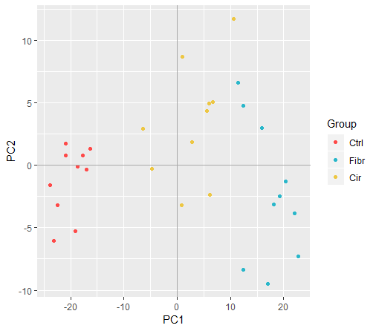
Our PCA is done!
Notes:
<number>

Slide 23
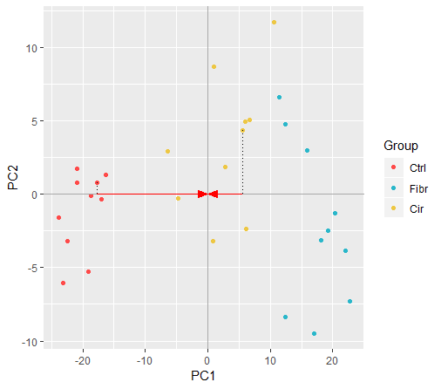
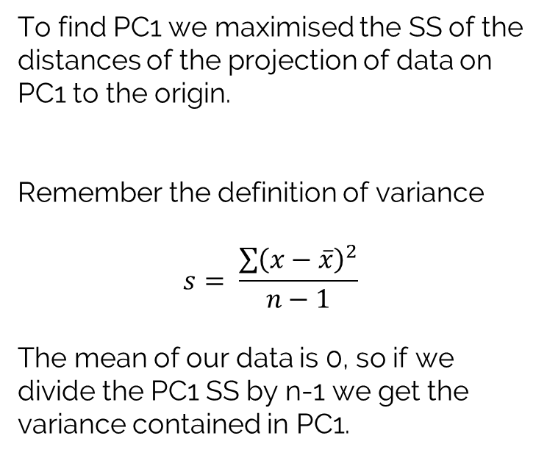
Variance explained
In our example:
var_{PC1} = 8.9239 var_{PC2} = 0.8477
So, PC1 explains 8.9/(8.9+0.8) = 91.3% of variance in the data and PC2 8.7%.
Notes:
SS distances = the eigenvalues
<number>

Slide 24
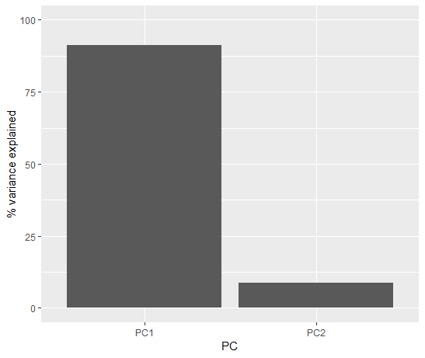
Scree plots
A common way to visualise the contribute of each component is through a scree plot, a bar plot of the variance explained.
Notes:
PC are ordered in order of importance
PC1 is capturing the majority of change in our data
We can get rid of PC2 (?)
<number>

Slide 25
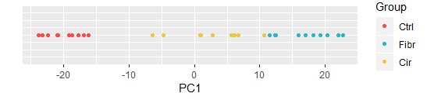
Dimension reduction
From 2D… …to 1D!
Notes:
<number>

Slide 26
A larger dataset!
Notes:
<number>

Slide 27
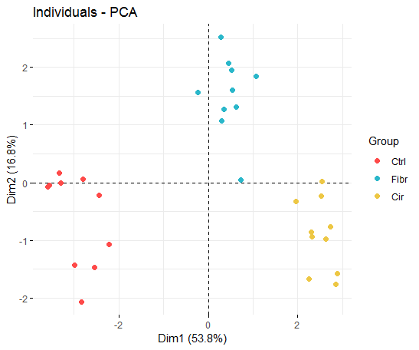
PCA
From 10D… …to 2D!
Notes:
<number>

Slide 28
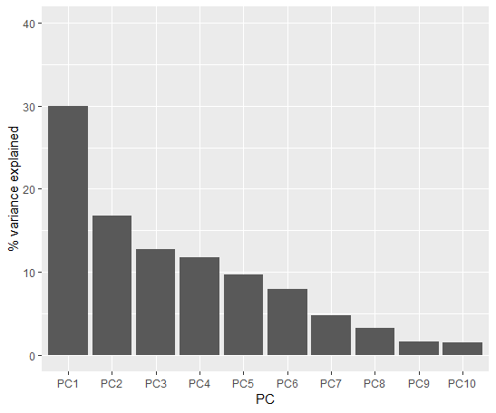
Scree plot
Notes:
<number>

Slide 29
Summary
PCA is one of the dimension reduction techniques, that allow reducing the number of variables in a dataset
Useful for simplify dataset with many variables
Useful to find groups of observations that differ because of complex relations between variables
It relies on rotating the data so that we express them relative to the direction in which they have biggest variance
Notes:
<number>

